Slide 1

Telling Meaningful Stories with Data
Orange County R Users Group
November 27, 2018
Alyssa Columbus
Datanaut, NASA - National Aeronautics and Space Administration
Data Scientist, Pacific Life

Slide 2
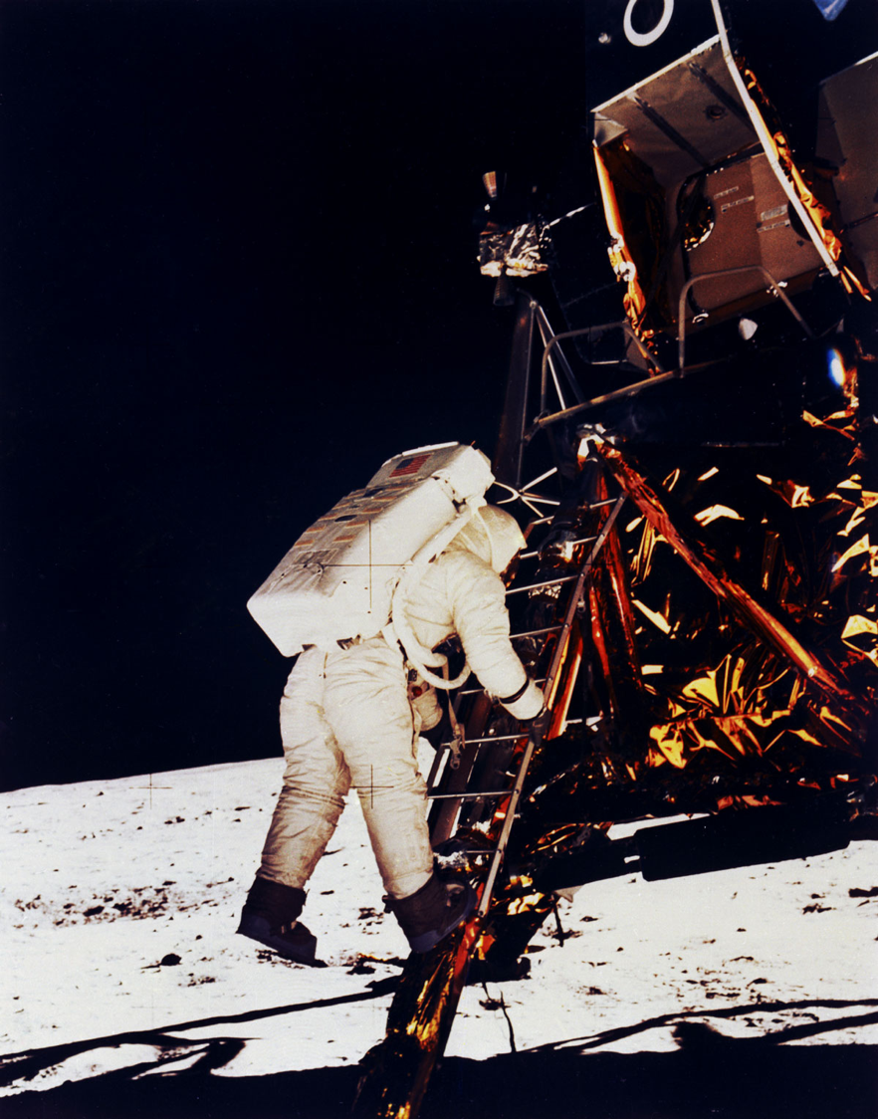

Slide 3
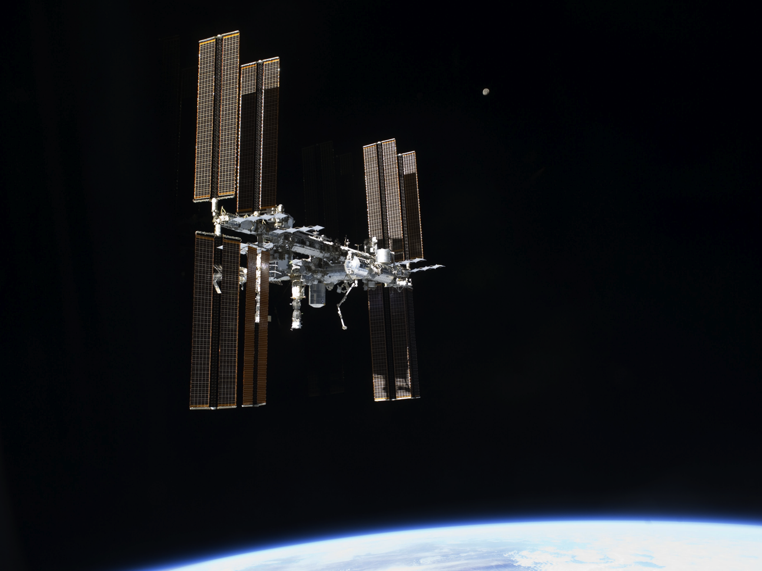

Slide 4
Principles of good
DATA JOURNALISM
are principles of good
DATA STORYTELLING.

Slide 5
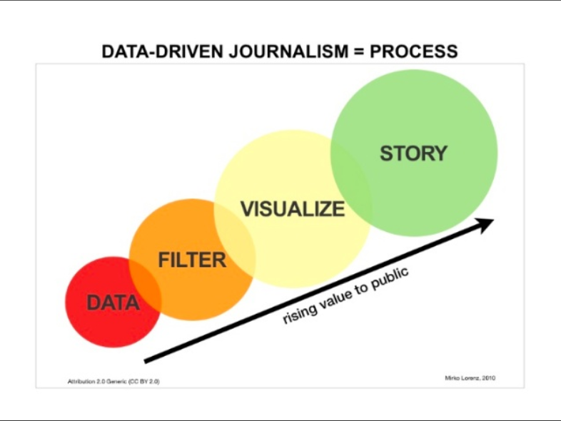

Slide 6
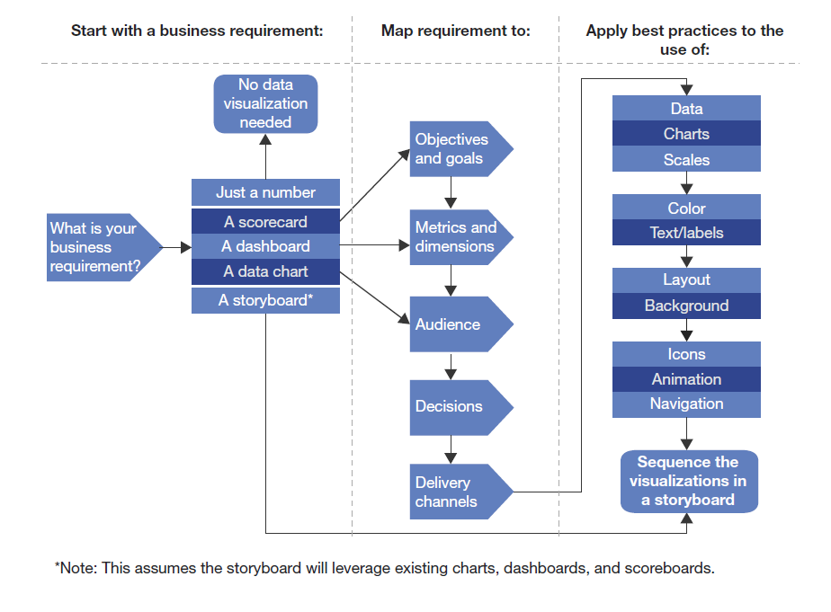
Data Visualization Design Process
Source: Forrester, Improve Your Storytelling With Data Visualization Best Practices December 28, 2017

Slide 7
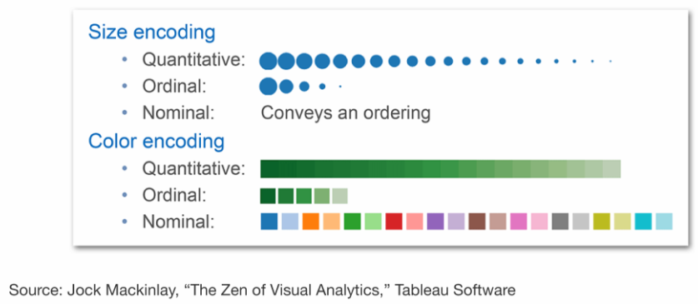
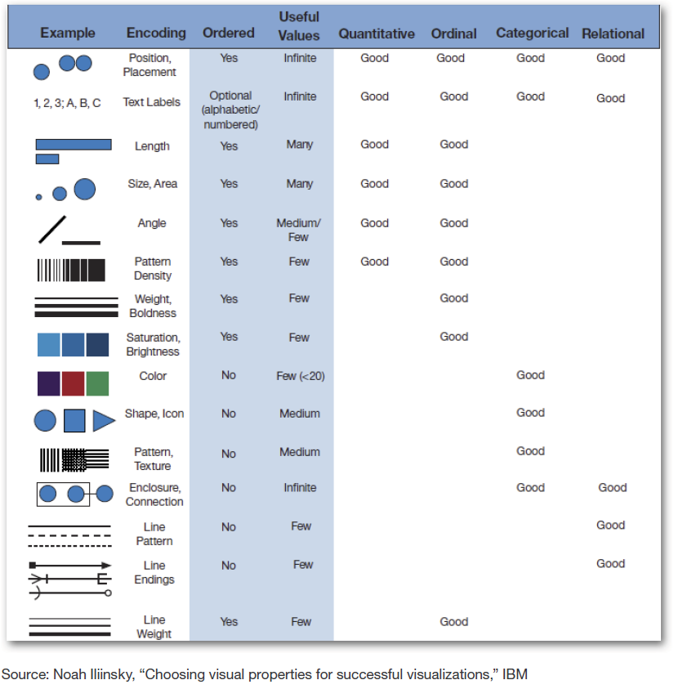
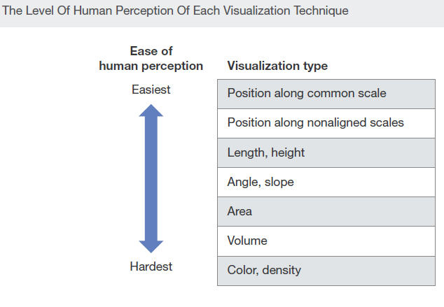
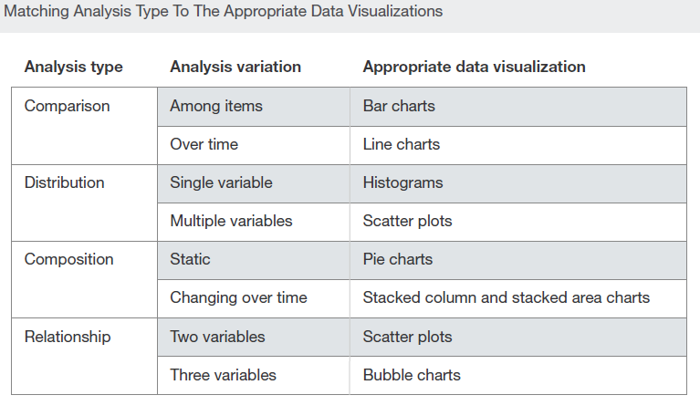
Visualization Techniques
7

Slide 8
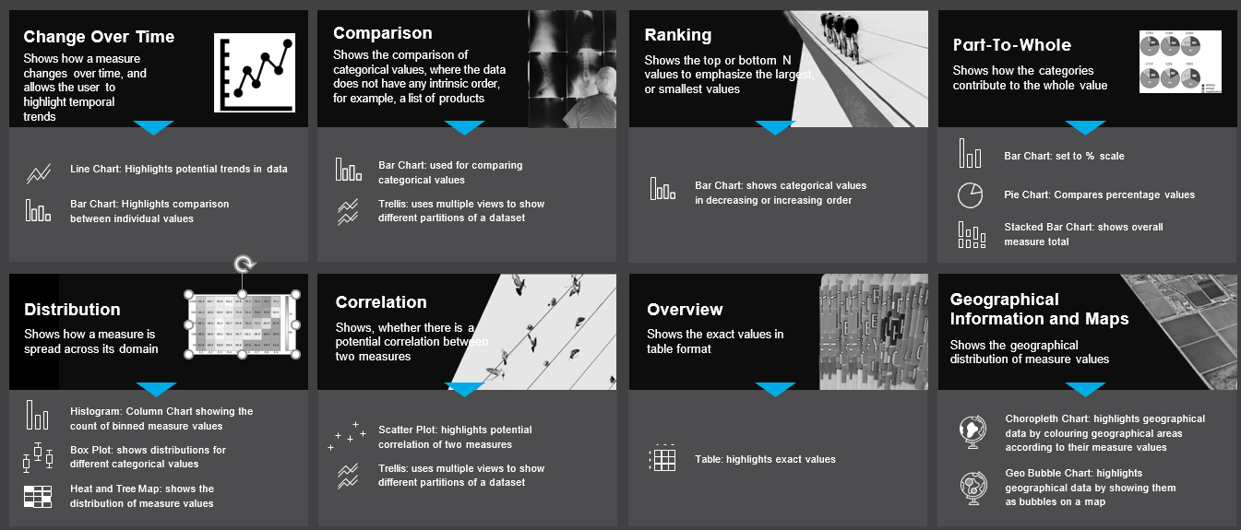
Selecting The Right Visualizations

Slide 9
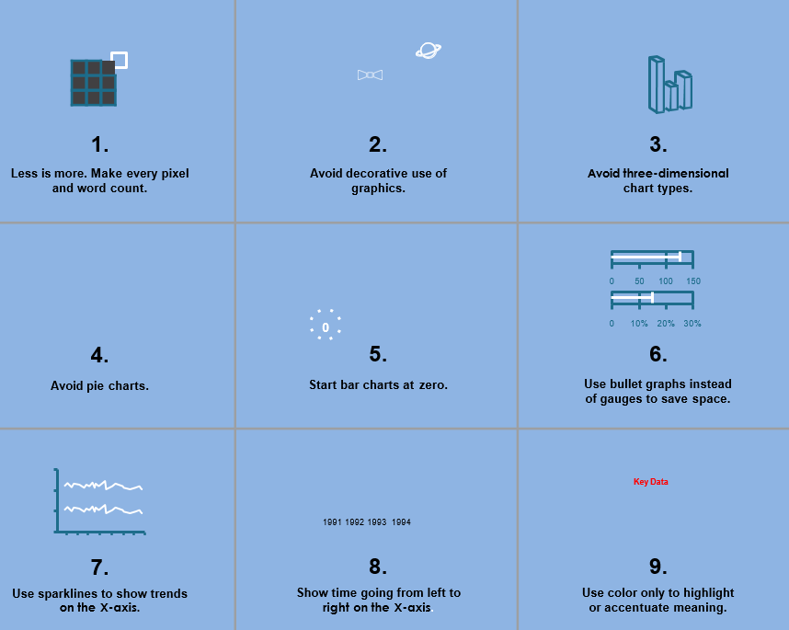
Pro Tips

Slide 10
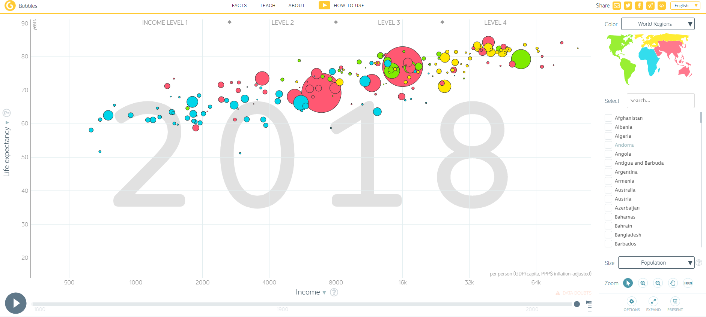
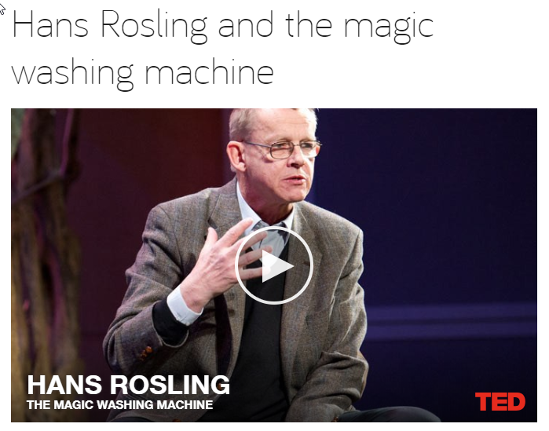
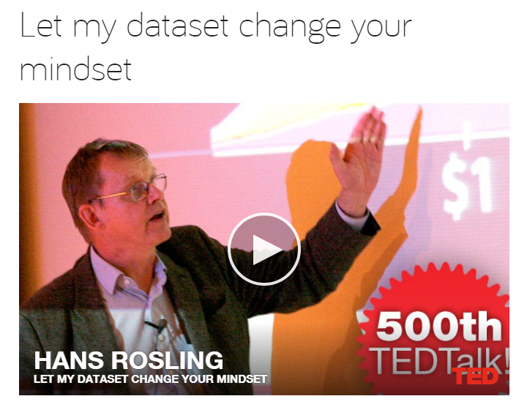
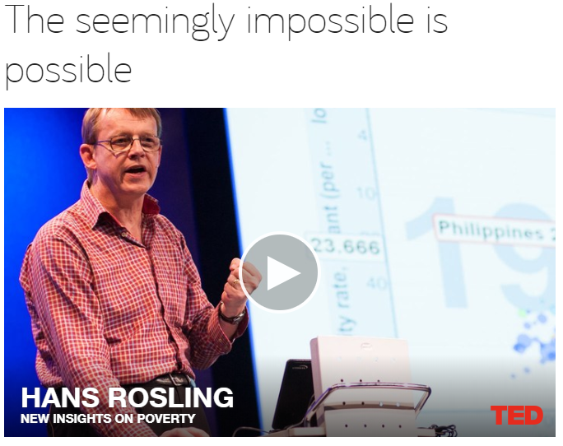
Explore GapMinder

Slide 11















Tools

Slide 12
DATA LEADS,
BUT STORY TELLS.

Slide 13
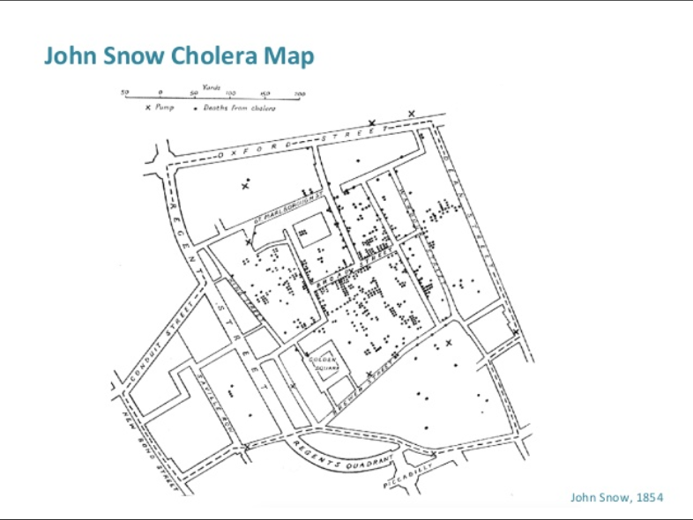

Slide 14
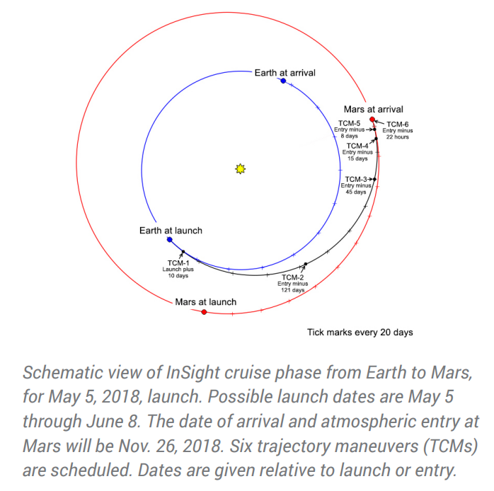
Source: NASA JPL

Slide 15
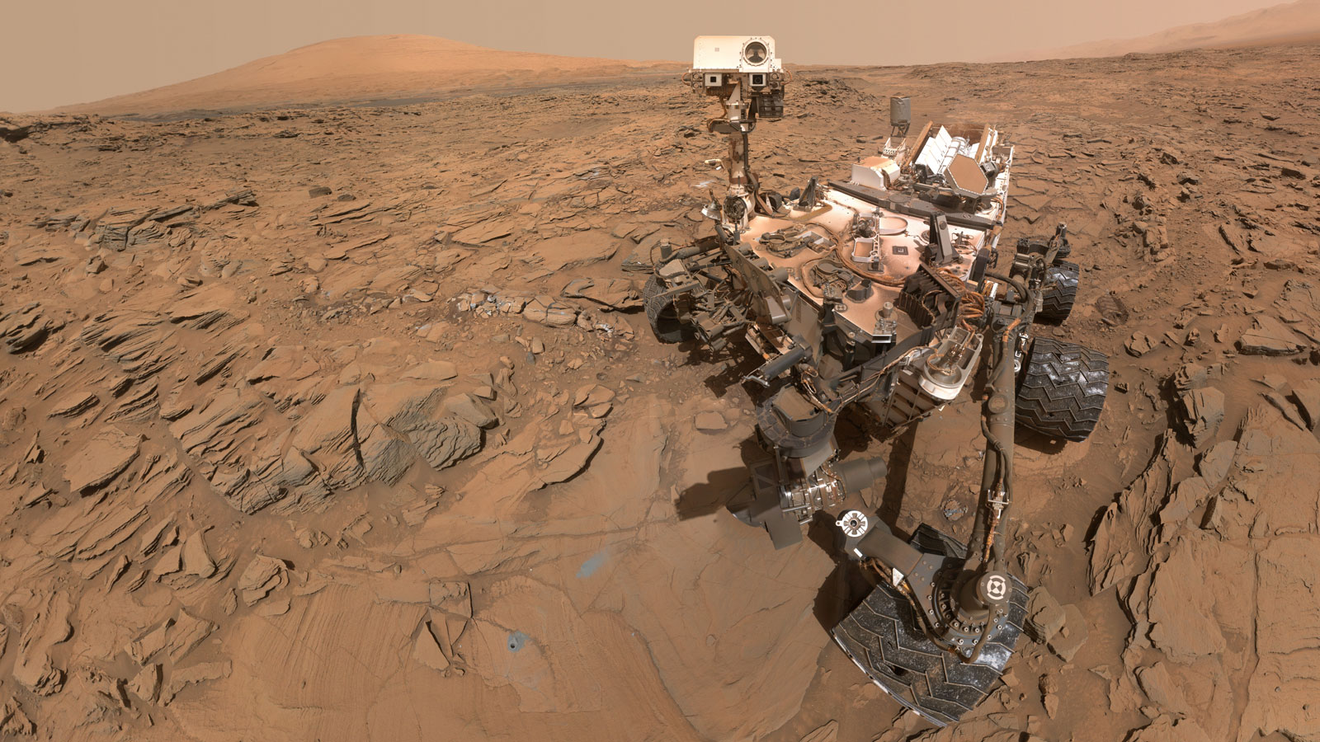
Source: NASA JPL

Slide 16
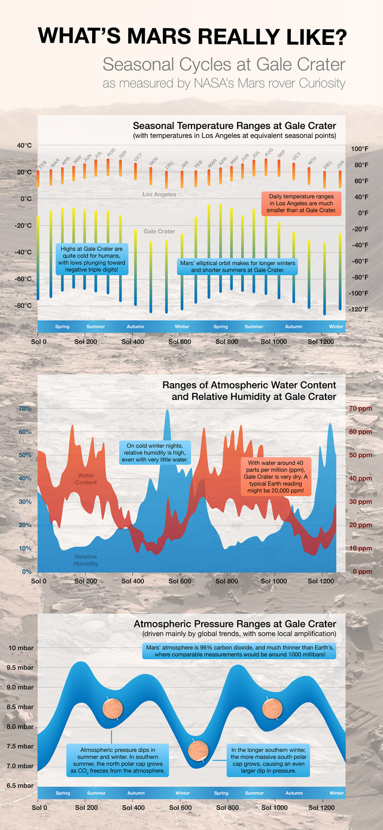
Source: NASA JPL
Source: NASA JPL

Slide 17
Source: NASA JPL

Slide 18
Source: NASA JPL

Slide 19

MAPPING DATA TO SENSES

Slide 20
SOUND

Slide 21
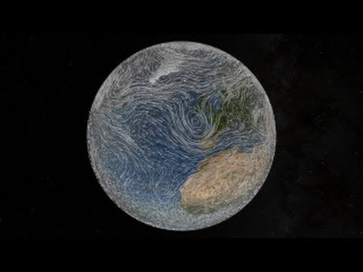
Source: NASA Scientific Visualization Studio

Slide 22

Source: Sound of Sorting

Slide 23
AUDIOJUNGLE.NET VIMEO.COM YOUTUBE

Slide 24

TOUCH

Slide 25

CLICK
SCROLL
DRAG
HOLD
RELEASE
SWIPE

Slide 26
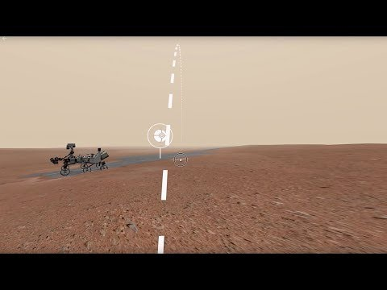

Slide 27


Slide 28
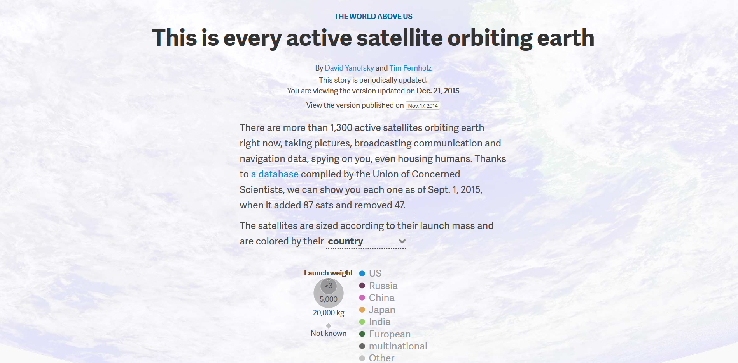
@alycolumbus
28

Slide 29
Good stories have…
Premise
Dramatic Question
Story Message

Slide 30
PREMISE
a universal truth, proverb, statement.
Example:
“We are only as strong as we are united, as weak as we are divided.”

Slide 31
DRAMATIC QUESTION
frames your debate for the viewer.
Example:
“What if ………………………………?”

Slide 32
STORY MESSAGE
why is this important? (right now?)
Example:
Example Story Message………..………..

Slide 33


Slide 34
PREMISE:
“Ruthless ambition leads to destruction.”
DRAMATIC QUESTION:
“What if you were in control of the largest army in the world?”
STORY MESSAGE:
“Don’t have the hubris to invade Russia in the winter.”

Slide 35
Data Scientists
Engineering
Math
Comp Sci
Science
nerds
nerds
nerds
nerds
awesome
nerds

Slide 36













RECOMMENDED READING
36

Slide 37
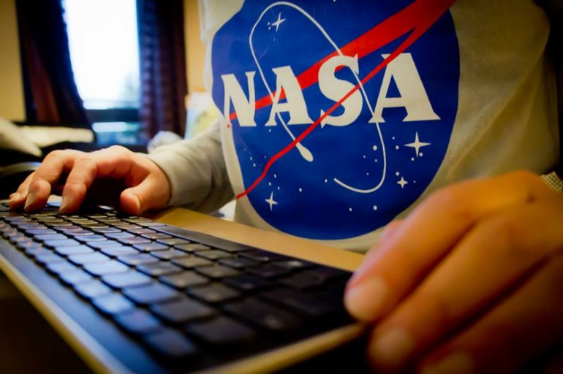
START WRITING TODAY

Slide 38

And you will find your unique VOICE.

Slide 39
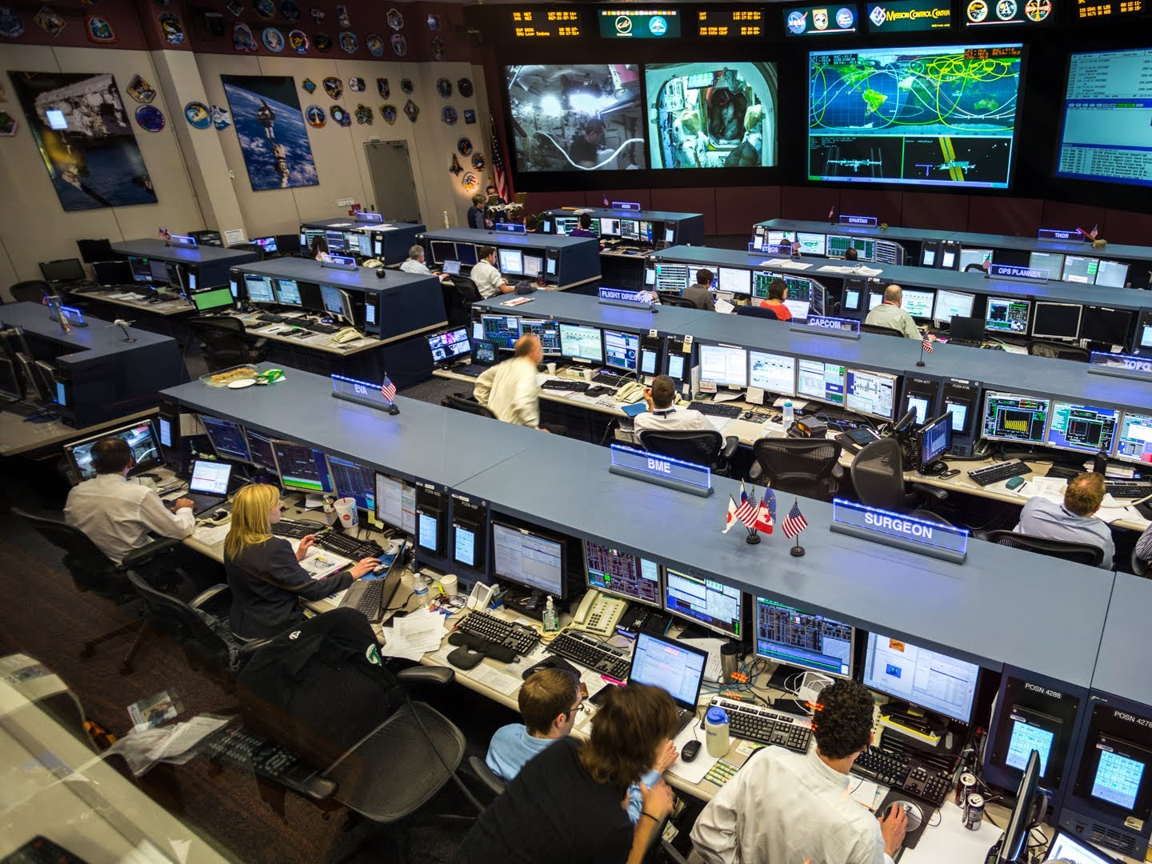
Respect & Serve Your Audience

Slide 40
Alyssa Columbus. @alycolumbus. alyssacolumbus.com

Slide 41
Backup Slides

Slide 42










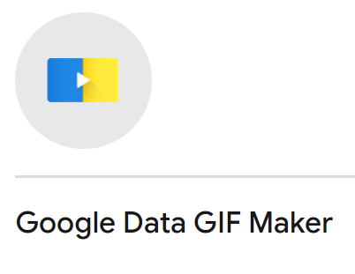


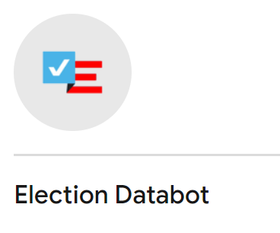

Data Journalism
https://newsinitiative.withgoogle.com/

Slide 43
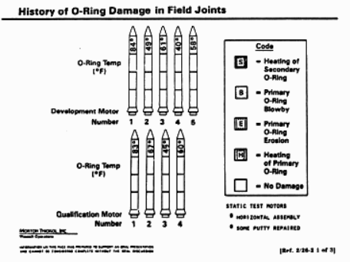
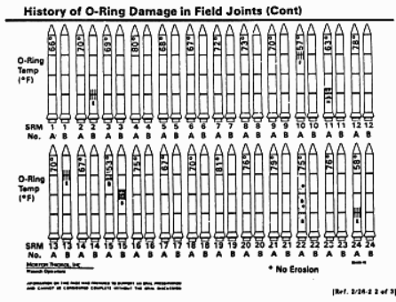
Data Journalism
Source: Presidential Commission on the Space Shuttle Challenger Accident, vol. 5 (Washington, DC: US Government Printing Office, 1986.) pp. 895-896.

Slide 44
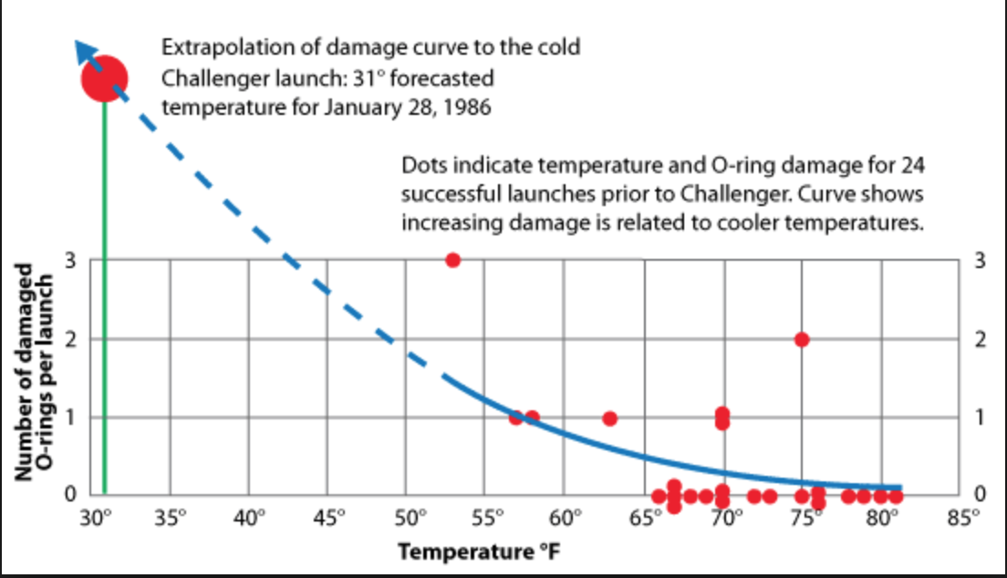
Data Journalism
Source: Presidential Commission on the Space Shuttle Challenger Accident, vol. 5 (Washington, DC: US Government Printing Office, 1986.) pp. 895-896.

